Slide 1


Email Spam Classifier
By: KUNIGIRI NAGARAJU

Slide 2
Introduction
The SMS Spam Collection is a set of SMS tagged messages that have been collected for SMS Spam research. It contains one set of SMS messages in English of 5,574 messages, tagged according being ham (legitimate) or spam.
What is a Spam Filtering
Spam Detector is used to detect unwanted, malicious and virus infected texts and helps to separate them from the nonspam texts. It uses a binary type of classification containing the labels such as ‘ham’ (nonspam) and spam. Application of this can be seen in Google Mail (GMAIL) where it segregates the spam emails in order to prevent them from getting into the user’s inbox.

Slide 3
Data Sources and their formats
In this project the sample data is provided to us from our client database. The dataset is in csv (comma seprated values) format.
The data set contains SMS tagged messages collected for SPAM Research
A collection of 5573 rows SMS spam messages was manually extracted from the Grumbletext Web site. This is a UK forum in which cell phone users make public claims about SMS spam messages, most of them without reporting the very spam message received. The identification of the text of spam messages in the claims is a very hard and time-consuming task, and it involved carefully scanning hundreds of web pages
A subset of 3,375 SMS randomly chosen ham messages of the NUS SMS Corpus (NSC), which is a dataset of about 10,000 legitimate messages collected for research at the Department of Computer Science at the National University of Singapore. The messages largely originate from Singaporeans and mostly from students attending the University. These messages were collected from volunteers who were made aware that their contributions were going to be made publicly available.
The data set includes:
v1: It is the Label column, which says spam or ham
v2: It contains the SMS or e-mail text content.
And other columns such as Unnamed:2, Unnamed:3, Unnamed:4.

Slide 4
Data Preprocessing
First we check the information of the given dataset because it tells that how many rows and columns are present in our dataset and data type of the columns whether they are object, integer or float.
Dropping duplicates rows if present in dataset.
Then we check for the null values present in our dataset. If null values are present then drop it because we cannot able to fill the text data.
After that we check the summary statistics of our dataset. This part tells about the statistics of our dataset i.e. mean, median, max value ,min values and also it tell whether outliers are present in our dataset or not.
We also check the correlation of our target features with each other. If columns are highly correlated with each other let’s say 90% or above then remove those columns to avoid multicollinearity problem
We also create new columns to check the length of data before cleaning the Input feature column.

Slide 5
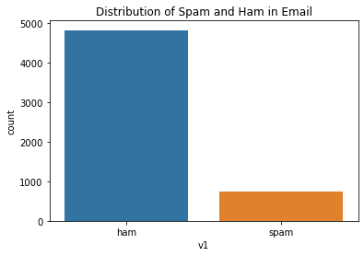
Data Visualization
This graph clearly shows that ham count is more and spam count is less comparatively

Slide 6
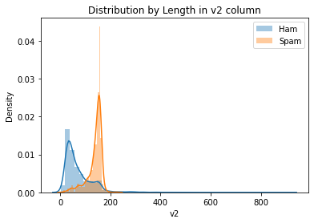
Data Visualization
This clearly shows that spam length density is high compared to ham

Slide 7
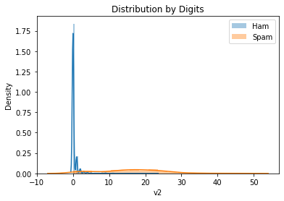
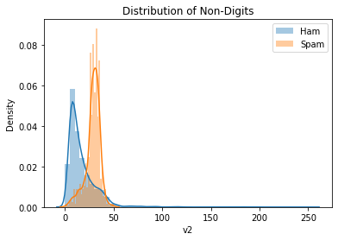
Data Visualization
In the above graphs we can see the distribution of digits is high in ham and Non-Digits in spam SMS e-mail content

Slide 8
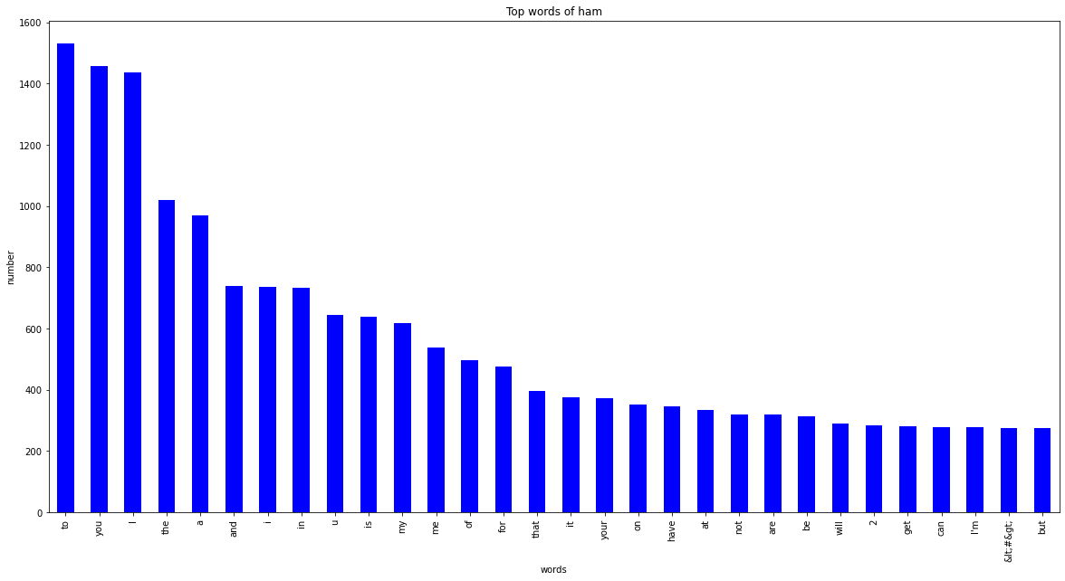
Data Visualization
These are the words in SPAM where “to” has highest of more than 1500 times and followed by “you”,”i”,”1”,”and”,”the”,”in”,”u”,”my”,”is”,”me”,”of”,”for,”that”,” it”,”your,”on”,”have” with more than 350 times

Slide 9
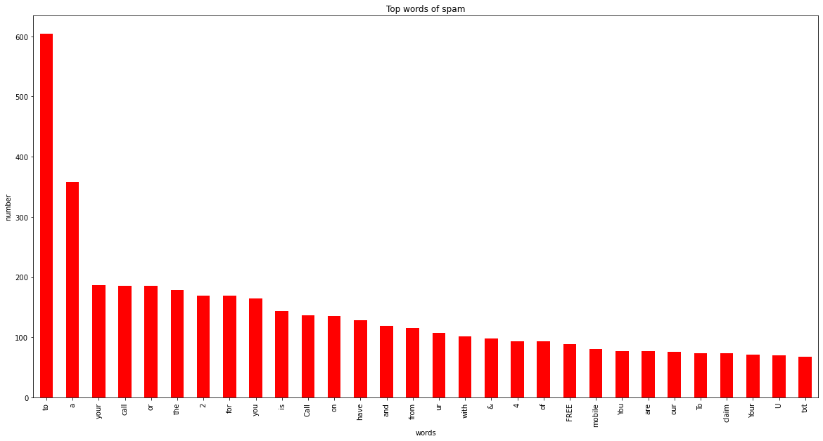
Data Visualization
These are the words in SPAM more than 100 words where “to” has highest of 368 words and followed by ,“a”,”your”,”call”,”or”,”the”,”2”,”for”,”call”,”is”,”on”,”have”,”from,”ur”,” with”,”&”,four,”of”,”FREE”

Slide 10
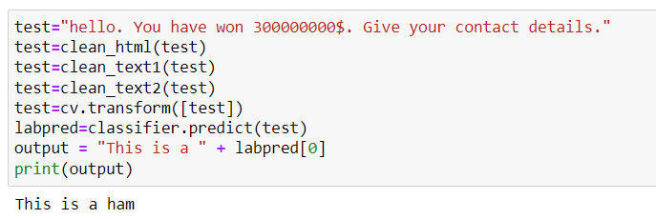
Finalising the Model
As per the prediction score SVM given us 98% of prediction compared to other models with recall and precision of 99% which fits our model with best params

Slide 11
Conclusion
In this project the sample data is provided from our client database. In this project, we addressed the task of data cleaning by grouping spam and ham. There are several limitations to the work on email spam classification using machine learning techniques. Some of these limitations include:
Evolving spam tactics: Spammers often use sophisticated tactics to evade detection, such as using images or JavaScript to conceal the true content of the email. These tactics can make it difficult for machine learning models to accurately classify spam emails, and they may require frequent updates and retraining to keep up with the latest spam techniques.
Limited generalizability: Machine learning models are generally only as good as the data they are trained on. If the training data is not representative of the types of emails that the classifier will encounter in the real world, the model may not generalize well and may produce poor results.
There is scope for future work in the area of email spam classification to address these limitations and improve the performance of machine learning models. This could include developing new algorithms and techniques for dealing with evolving spam tactics, increasing the diversity and representativeness of the training data, and addressing bias in the data. Additionally, there may be opportunities to integrate email spam classification with other tools and systems, such as email servers and email clients, to improve the overall effectiveness of spam prevention.

Slide 12
Introduction

